Slide 1

Title
An "Arduino-Powered Number’s Conversion System"
COURSE CODE / NAME
DSA0110 / OBJECT ORIENTED PROGRAMMING WITH C++ FOR PROBLEM SOLVING

Slide 2
Abstract
This project aims to design and implement a system that converts decimal numbers to binary using an Arduino microcontroller, focusing on providing an interactive tool for understanding data representation in a hardware environment. The system is equipped with a 4x4 keypad for user input and an I2C (Inter-Integrated Circuit) LCD display for output, which together enable e
.When a user enters a decimal number on the keypad, the Arduino processes the input, converts it into binary form, and displays the result instantly on the LCD screen. This setup illustrates the process of binary conversion in a clear, hands-on manner, allowing users to visualize how decimal numbers are represented in binary .
This project serves as an educational tool, leveraging hardware to make abstract concepts of data representation more tangible. The Arduino’s efficiency in performing the conversion and updating the display showcases how embedded systems can be applied to teach foundational computing principles.

Slide 3
Objective
Problem Statement:
Data representation in computing relies on binary numbers, but converting decimal numbers to binary manually or using software can be inefficient for beginners. This project creates a hardware-based solution using Arduino for fast, hands-on conversion.
A fully functional system that converts decimal to binary, displays the result on an I2C LCD screen, and accepts input via a 4x4 keypad. Future enhancements may include handling larger numbers or adding additional features for educational purposes.
Project Goals:
1. Build a system that converts decimal to binary using an Arduino UNO R3.
2. Utilize a 4x4 keypad for user input and an I2C LCD display for output.

Slide 4
Introduction
Binary numbers are at the core of digital systems, but learning to convert decimal numbers to binary can be confusing, especially for beginners. This project makes the process easier and more interactive by using an Arduino-based system to instantly convert decimal numbers into binary.
Here’s how it works: Users enter a decimal number using a 4x4 keypad. The Arduino then processes this number, converts it to binary, and displays the result on an I2C LCD screen. This setup gives immediate feedback, so users can see how decimal numbers are represented in binary form right away.
Using an Arduino UNO R3 is ideal because it’s simple, widely available, and easy for beginners to work with. This project not only helps learners understand binary numbers but also shows how microcontrollers like Arduino can be powerful tools for teaching digital concepts.

Slide 5
ANALYSIS
System Performance:
Test the system for speed and accuracy. The Arduino should quickly process input from the keypad and display the binary result on the LCD with minimal delay.
The 4x4 keypad must be responsive and accurately capture the user’s inputs. During testing, the system’s ability to handle multiple key presses in quick succession should be evaluated. Potential delays or missed keypresses can negatively impact user experience and learning outcomes.
The I2C LCD should clear and update its content quickly. Any lag between entering a decimal number and displaying the corresponding binary number could cause confusion for users, especially in educational settings.
Consider how the system handles edge cases, such as pressing non-numeric keys on the keypad (A, B, C, D, *, and #). Implement error handling that either ignores these keys or provides feedback on the LCD, ensuring that only valid decimal numbers are converted.

Slide 6
System design
System Architecture: The system is built around an Arduino UNO R3, with a 4x4 keypad for decimal input, an I2C LCD display for binary output, and connecting wires.
Hardware Components:
Arduino UNO R3: The main processor handling input and output.
I2C LCD Display (16x2): Shows the binary output; uses only four wires for easy communication.
4x4 Keypad: Allows users to input decimal numbers.
Connecting Wires: Links all components to the Arduino.
Software Design: The Arduino code reads the decimal input from the keypad, converts it to binary, and displays the result on the LCD. The Arduino IDE is used to program and upload code to the board.

Slide 7
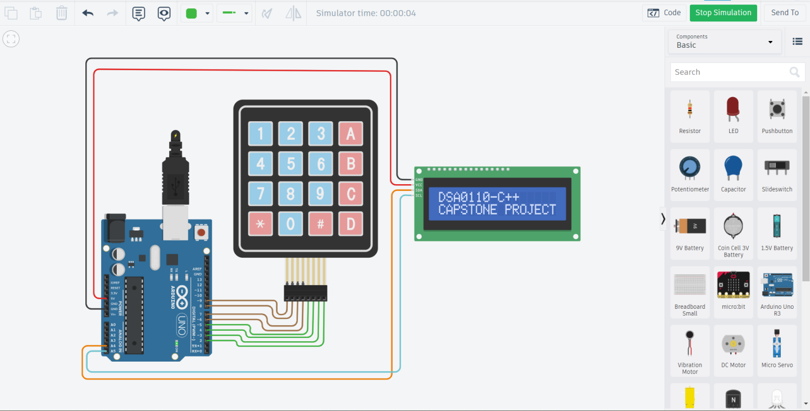
Results

Slide 8
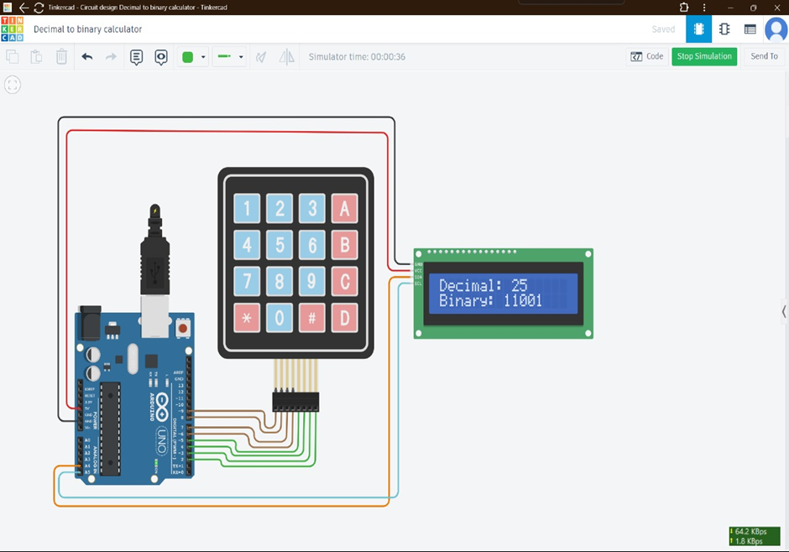
Decimal to binary conversion system

Slide 9
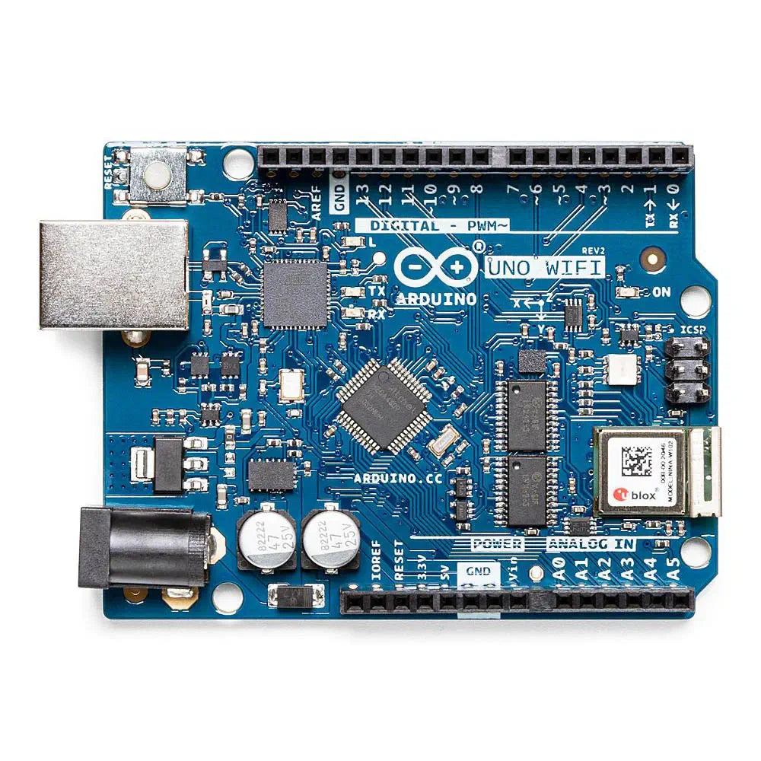
Challenges and solutions
1. Limited Pins:
The I2C protocol minimizes the number of pins required for the LCD, making it easier to interface both the keypad and the display with the Arduino.
2. Keypad Handling:
Debouncing or incorrect key detection may be an issue. Using built-in libraries simplifies handling multiple keypresses.

Slide 10
Conclusion
Summary of Outcomes:
Accurate Conversion: Converts decimal to binary instantly with accurate display on the LCD.
Interactive Learning: Provides a hands-on way to understand binary numbers.
User-Friendly: Simple interface using a 4x4 keypad and I2C LCD.
Real-Time Processing: Fast response enhances understanding of digital systems.
Simplified Setup: Minimal wiring due to I2C LCD integration.
Educational Value: Ideal for teaching binary concepts and Arduino applications.
Versatile and Expandable: Can be adapted for other educational uses.

